Slide 1



RaiTech Computer Repairs and Internet Cafe
By: Tajae Gordon

Slide 2
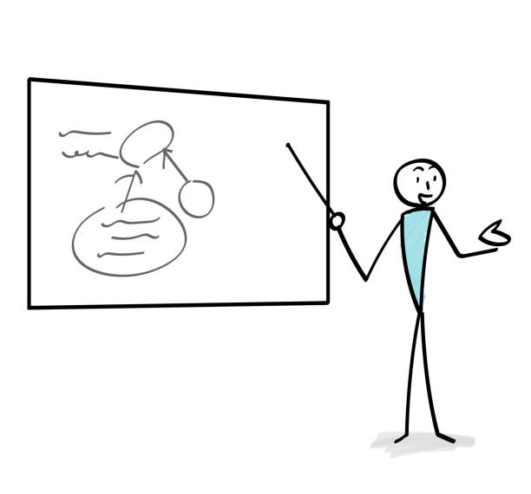
Introduction
Hello everyone, thank you for joining us today. I'm Tajae Gordon, co-founder of RaiTech Computer Repairs and Internet Cafe, and I'm excited to share our innovative business concept with you.

Slide 3

Problem Statement
In today's digital age, reliable technology and convenient workspaces are essential. Yet, finding a place that offers both quality computer repair services and a comfortable environment to work and connect can be challenging.

Slide 4


Solution
At RaiTech, we're bridging this gap by combining top-notch computer repair expertise with a modern internet cafe experience. Our goal is to create a one-stop destination where customers can get their tech issues resolved while enjoying a welcoming space to relax or be productive.

Slide 5

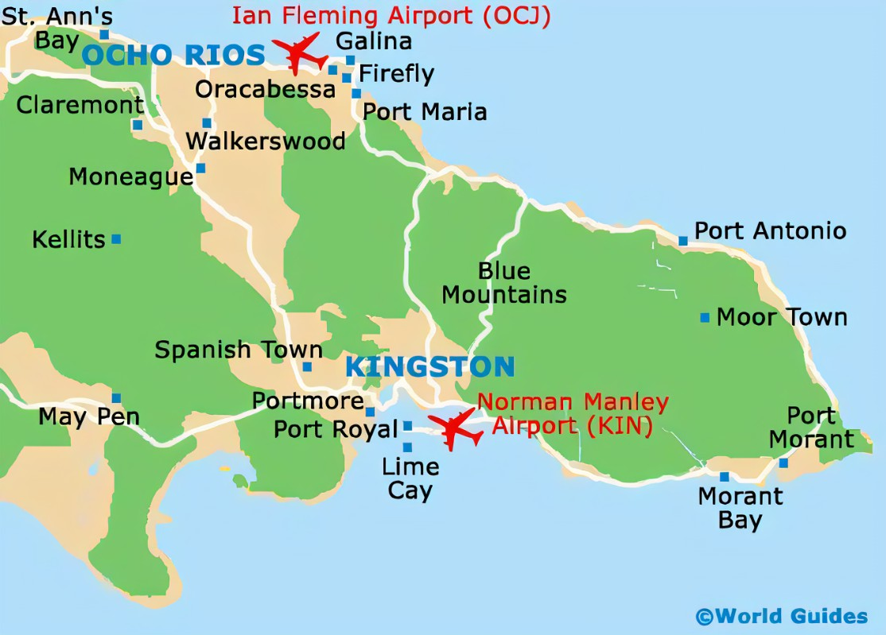
Market Opportunity
The market demand for computer repairs and internet cafe facilities is robust. We've identified a prime location with a diverse target audience, ranging from students and professionals to gamers and tourists. Our in-depth market analysis shows that the local market is ripe for a unique offering like RaiTech.

Slide 6

Competitive Advantage
What sets us apart is our dual expertise in technology and hospitality. We're not just fixing computers; we're creating an environment that fosters community engagement. Our team's technical prowess ensures reliable solutions, while our inviting cafe ambiance promotes relaxation and productivity.

Slide 7
Financial Projections and Budgeting
Let's delve into the numbers. Our startup costs, including leasehold improvements, equipment, and initial marketing efforts, total $500,000. We project conservative revenue growth, reaching $1,000,000 by year three. With prudent budgeting, we anticipate achieving profitability within the first 18 months.

Slide 8

Managing Cash Flow
To maintain a healthy cash flow, we've implemented rigorous expense management strategies and are closely monitoring our spending patterns. We've also negotiated favorable credit terms with suppliers, ensuring we have sufficient liquidity for day-to-day operations.

Slide 9


Source of Funding
We're passionate about our vision, and to date, we've been bootstrapping the business. Our founders, Tajae Gordon and Alexia Turner, have contributed a portion of the initial investment. We're also exploring local grants and incubator programs to supplement our funding needs.

Slide 10
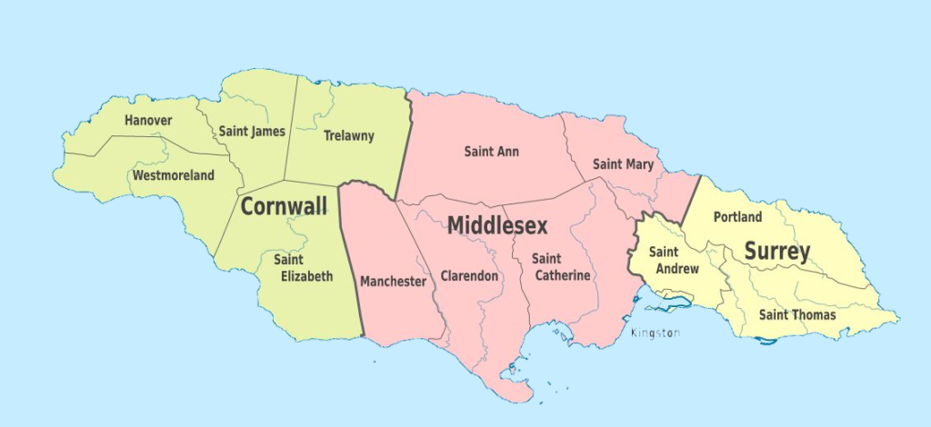
Expansion Plan
Looking ahead, our growth strategy involves expanding to multiple locations within the city of Kingston and its surrounding parishes. We're excited about the potential to partner with local educational institutions to offer tech workshops, further enhancing our community engagement.

Slide 11
Conclusion
In closing, RaiTech Computer Repairs and Internet Cafe is poised to become a hub for technology enthusiasts, professionals, and casual cafe-goers alike. We're offering a unique solution to a pressing need in the market while meticulously managing our finances. We invite you to join us on this exciting journey and be part of redefining the tech and cafe experience in our city.

Slide 12
THANK YOU FOR YOUR TIME

